Slide 1
ECE 352 Digital System Fundamentals
Optimization with K-Maps
Notes:
In this presentation, we will discuss circuit optimization with K-maps.

Slide 2
Topics
Optimization with K-Maps
Implicants, Prime Implicants, Essential Prime Implicants
General K-Map Solution Process
K-Maps and Product of Sums Form
Notes:
First, we need to get through some terminology. Then we’ll develop a general solution for creating an optimal Sum of Products solution from a K-map. Finally, we will extend the use of the K-map to creating Product of Sums implementations.

Slide 3
K-Map Terminology
Implicant: any product term (group) where all included minterms are 1
Prime Implicants: implicant where removing any literal would make a non-implicant product term
Rephrased: a group that cannot be doubled in size in any direction without causing it to include a 0
Essential Prime Implicants: A prime implicant that is the only choice for covering a needed minterm
“Only choice” from the set of all possible prime implicants
Will be in the equation—no choice—write down that term right away when solving a K-map
Selection Rule: Each prime implicant in the solution must include at least one minterm not included in any other prime implicant in the solution
“Don’t add a group if you don’t need to”***
*** Later in the course we’ll talk about a reason to do this!
Notes:
Let’s start with the terminology. An implicant is simply any valid grouping of 1s in a K-map. By valid, we mean that it is a rectangular group of squares where both dimensions are powers of 2, and the group only includes squares with 1s. A prime implicant is an implicant where removing any literal would result in a term that is not a valid implicant. What this means is that a prime implicant is an implicant that cannot be made any larger without including one or more 0s, which of course would not be a valid implicant. Prime implicants are important because we ONLY use prime implicants in an optimal circuit implementation. An essential prime implicant is a prime implicant that is the only choice for covering a 1 in the K-map. Another way of looking at this is that an essential prime implicant must contain at least one 1 that is not contained in any other prime implicant. We say it is “essential” because you MUST include all essential prime implicants in the optimal circuit implementation. We must include all essential prime implicants in the optimized solution, but what if there are other 1s in the map that were not part of any of the essential prime implicants? Which other prime implicants do we need to include? The selection rule says that every prime implicant in the solution must include at least one minterm that is not included in any other prime implicant in the solution. In practical terms, the selection rule says to only include the necessary groups in the solution – if a prime implicant only includes 1s covered by other included prime implicants, it is redundant and should not be part of the solution.

Slide 4
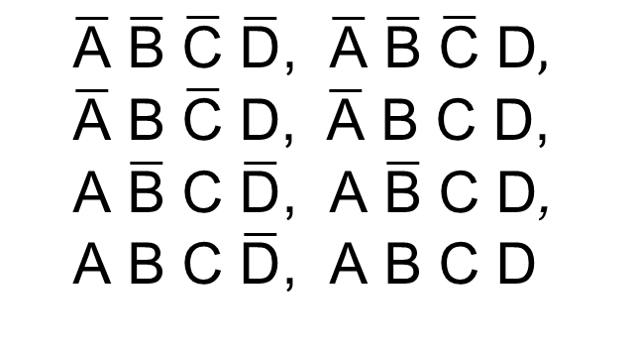
Example: Implicants
Size 1 Implicants:
CD
AB
00
01
11
10
$$\overline{\text{A}} \overline{\text{B}} \overline{\text{C}} \overline{\text{D}}\text{, }\overline{\text{A}} \overline{\text{B}} \overline{\text{C}} \text{D}, \\ \overline{\text{A}} \text{B} \overline{\text{C}} \text{D}\text{, } \overline{\text{A}} \text{B} \text{C} \text{D}\text{,} \\ \text{A} \overline{\text{B}} \text{C} \overline{\text{D}}\text{, }\text{A} \overline{\text{B}} \text{C} \text{D}\text{,} \\ \text{A} \text{B} \text{C} \overline{\text{D}}\text{, }\text{A} \text{B} \text{C} \text{D}$$
00
1
1
0
0
01
0
1
1
0
11
0
0
1
1
10
0
0
1
1
Notes:
Now let’s see how this works on a K-map. First, let’s identify all size 1 implicants. You can see that we have eight of them, since there are eight 1s in the K-map. Note that none of the size 1 implicants are prime – they can all be at least doubled in size.

Slide 5
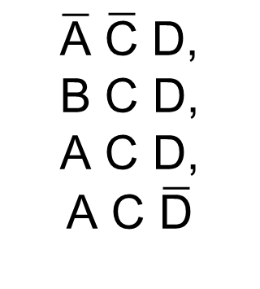
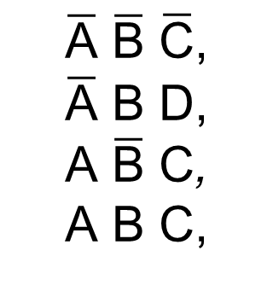
Example: Implicants
Size 1 Implicants:
CD
AB
00
01
11
10
$$\overline{\text{A}} \overline{\text{B}} \overline{\text{C}} \overline{\text{D}}\text{, }\overline{\text{A}} \overline{\text{B}} \overline{\text{C}} \text{D}, \\ \overline{\text{A}} \text{B} \overline{\text{C}} \text{D}\text{, } \overline{\text{A}} \text{B} \text{C} \text{D}\text{,} \\ \text{A} \overline{\text{B}} \text{C} \overline{\text{D}}\text{, }\text{A} \overline{\text{B}} \text{C} \text{D}\text{,} \\ \text{A} \text{B} \text{C} \overline{\text{D}}\text{, }\text{A} \text{B} \text{C} \text{D}$$
00
1
1
0
0
01
0
1
1
0
Size 2 Implicants:
11
0
0
1
1
$$\overline{\text{A}} \overline{\text{B}} \overline{\text{C}}\text{,} \\ \overline{\text{A}} \text{B} \text{D}\text{,} \\ \text{A} \overline{\text{B}} \text{C}\text{,} \\ \text{A} \text{B} \text{C}\text{,}$$
$$\overline{\text{A}} \overline{\text{C}} \text{D}\text{,} \\ \text{B} \text{C} \text{D}\text{,} \\ \text{A} \text{C} \text{D}\text{,}$$
$$\text{A} \text{C} \overline{\text{D}}$$
10
0
0
1
1
Notes:
Now, let’s find all size 2 implicants. You can see that we also have eight of them.

Slide 6

Example: Implicants
Size 1 Implicants:
CD
AB
00
01
11
10
$$\overline{\text{A}} \overline{\text{B}} \overline{\text{C}} \overline{\text{D}}\text{, }\overline{\text{A}} \overline{\text{B}} \overline{\text{C}} \text{D}, \\ \overline{\text{A}} \text{B} \overline{\text{C}} \text{D}\text{, } \overline{\text{A}} \text{B} \text{C} \text{D}\text{,} \\ \text{A} \overline{\text{B}} \text{C} \overline{\text{D}}\text{, }\text{A} \overline{\text{B}} \text{C} \text{D}\text{,} \\ \text{A} \text{B} \text{C} \overline{\text{D}}\text{, }\text{A} \text{B} \text{C} \text{D}$$
00
1
1
0
0
01
0
1
1
0
Size 2 Implicants:
11
0
0
1
1
$$\overline{\text{A}} \overline{\text{B}} \overline{\text{C}}\text{,} \\ \overline{\text{A}} \text{B} \text{D}\text{,} \\ \text{A} \overline{\text{B}} \text{C}\text{,} \\ \text{A} \text{B} \text{C}\text{,}$$
$$\overline{\text{A}} \overline{\text{C}} \text{D}\text{,} \\ \text{B} \text{C} \text{D}\text{,} \\ \text{A} \text{C} \text{D}\text{,}$$
$$\text{A} \text{C} \overline{\text{D}}$$
10
0
0
1
1
Size 4 Implicants:
$$\text{A} \text{C}$$
Notes:
There is only one size 4 implicant.

Slide 7
Example: Implicants
Size 1 Implicants:
CD
AB
00
01
11
10
$$\overline{\text{A}} \overline{\text{B}} \overline{\text{C}} \overline{\text{D}}\text{, }\overline{\text{A}} \overline{\text{B}} \overline{\text{C}} \text{D}, \\ \overline{\text{A}} \text{B} \overline{\text{C}} \text{D}\text{, } \overline{\text{A}} \text{B} \text{C} \text{D}\text{,} \\ \text{A} \overline{\text{B}} \text{C} \overline{\text{D}}\text{, }\text{A} \overline{\text{B}} \text{C} \text{D}\text{,} \\ \text{A} \text{B} \text{C} \overline{\text{D}}\text{, }\text{A} \text{B} \text{C} \text{D}$$
00
1
1
0
0
01
0
1
1
0
Size 2 Implicants:
11
0
0
1
1
$$\overline{\text{A}} \overline{\text{B}} \overline{\text{C}}\text{,} \\ \overline{\text{A}} \text{B} \text{D}\text{,} \\ \text{A} \overline{\text{B}} \text{C}\text{,} \\ \text{A} \text{B} \text{C}\text{,}$$
$$\overline{\text{A}} \overline{\text{C}} \text{D}\text{,} \\ \text{B} \text{C} \text{D}\text{,} \\ \text{A} \text{C} \text{D}\text{,}$$
$$\text{A} \text{C} \overline{\text{D}}$$
10
0
0
1
1
No Size 8 Implicants
No Size 16 Implicants
Size 4 Implicants:
$$\text{A} \text{C}$$
Notes:
And there are no size 8 or larger implicants.

Slide 8
Example: Prime Implicants (PIs)
Size 1 Implicants:
CD
AB
00
01
11
10
$$\overline{\text{A}} \overline{\text{B}} \overline{\text{C}} \overline{\text{D}}\text{, }\overline{\text{A}} \overline{\text{B}} \overline{\text{C}} \text{D}, \\ \overline{\text{A}} \text{B} \overline{\text{C}} \text{D}\text{, } \overline{\text{A}} \text{B} \text{C} \text{D}\text{,} \\ \text{A} \overline{\text{B}} \text{C} \overline{\text{D}}\text{, }\text{A} \overline{\text{B}} \text{C} \text{D}\text{,} \\ \text{A} \text{B} \text{C} \overline{\text{D}}\text{, }\text{A} \text{B} \text{C} \text{D}$$
00
1
1
0
0
0
0
01
0
1
1
0
0
0
Size 2 Implicants:
11
0
0
1
1
0
0
$$\overline{\text{A}} \overline{\text{B}} \overline{\text{C}}\text{,} \\ \overline{\text{A}} \text{B} \text{D}\text{,} \\ \text{A} \overline{\text{B}} \text{C}\text{,} \\ \text{A} \text{B} \text{C}\text{,}$$
$$\overline{\text{A}} \overline{\text{C}} \text{D}\text{,} \\ \text{B} \text{C} \text{D}\text{,} \\ \text{A} \text{C} \text{D}\text{,}$$
$$\text{A} \text{C} \overline{\text{D}}$$
10
0
0
1
1
0
0
No Size 8 Implicants
No Size 16 Implicants
Size 4 Implicants:
$$\text{A} \text{C}$$
Notes:
Which of the implicants are prime? Remember that a prime implicant is an implicant that cannot be made larger. To find them, we examine each implicant and see whether or not we can double its size in some dimension without including a 0. If not, it is prime. After doing that, we see that there are five prime implicants.

Slide 9
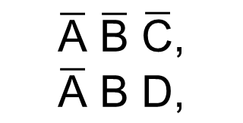

Example: Prime Implicants (PIs)
ESSENTIAL PIs
Size 1 PIs:
CD
AB
00
01
11
10
NONE
00
1
1
0
0
01
0
1
1
0
Size 2 PIs:
11
0
0
1
1
$$\overline{\text{A}} \overline{\text{B}} \overline{\text{C}}\text{,} \\ \overline{\text{A}} \text{B} \text{D}\text{,}$$
$$\overline{\text{A}} \overline{\text{C}} \text{D}\text{,} \\ \text{B} \text{C} \text{D}$$
10
0
0
1
1
No Size 8 PIs
No Size 16 PIs
Size 4 PIs:
$$\text{A} \text{C}$$
Notes:
Remember that ONLY the prime implicants can be used in an optimized implementation. Now, we need to determine if there are any essential prime implicants. We examine each prime implicant, looking to see if it includes a 1 that is not included in any other prime implicant. In this case, there are two essential prime implicants.

Slide 10
General K-Map Solution Process
Find all of the prime implicants (PIs)
The only implicants we consider adding to the equation
Remember, these are the groups that are as big as possible (to make the AND gates small as possible)
Include any essential PIs in the equation immediately (we know we need them)
If all 1s are not covered:
Eliminate any completely redundant (only cover already-covered 1s) PIs from further consideration
Cover remaining uncovered 1s with non-essential PIs
Choose PIs to add based on minimizing overlap with included PIs and maximizing “new” 1s covered
Stop when all 1s are covered
Notes:
Once we have identified the prime and essential prime implicants, we can find the optimal solution. We know that we will only consider prime implicants in the solution, and that we MUST include all essential prime implicants. If the essential prime implicants don’t cover all of the 1s in the K-map, then we need to choose other prime implicants to cover those 1s. We want to select the fewest and largest prime implicants possible. When all 1s are covered, we’re done.

Slide 11


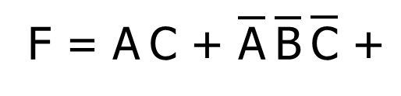


Example Solution Process
ESSENTIAL PIs
Size 1 PIs:
CD
AB
00
01
11
10
NONE
00
1
1
0
0
01
0
1
1
0
Size 2 PIs:
11
0
0
1
1
$$\overline{\text{A}} \overline{\text{B}} \overline{\text{C}}\text{,} \\ \overline{\text{A}} \text{B} \text{D}\text{,}$$
$$\overline{\text{A}} \overline{\text{C}} \text{D}\text{,} \\ \text{B} \text{C} \text{D}$$
10
0
0
1
1
F = $\text{A} \text{C}\text{ + }\overline{\text{A}} \overline{\text{B}} \overline{\text{C}}\text{ +}$
$$\overline{\text{A}} \text{B} \text{D}$$
Size 4 PIs:
$$\text{A} \text{C}$$
Notes:
So, for the example we were working on, we first select the two essential prime implicants. This leaves two 1s uncovered, and we can select a single prime implicant to cover both of them. So, the optimal solution is the OR of the selected implicants.

Slide 12
Topics
Optimization with K-Maps
Implicants, Prime Implicants, Essential Prime Implicants
General K-Map Solution Process
K-Maps and Product of Sums Form
Notes:
Now, let’s switch gears a bit and look at how a K-map can also be used to create an optimal Product of Sums implementation.

Slide 13
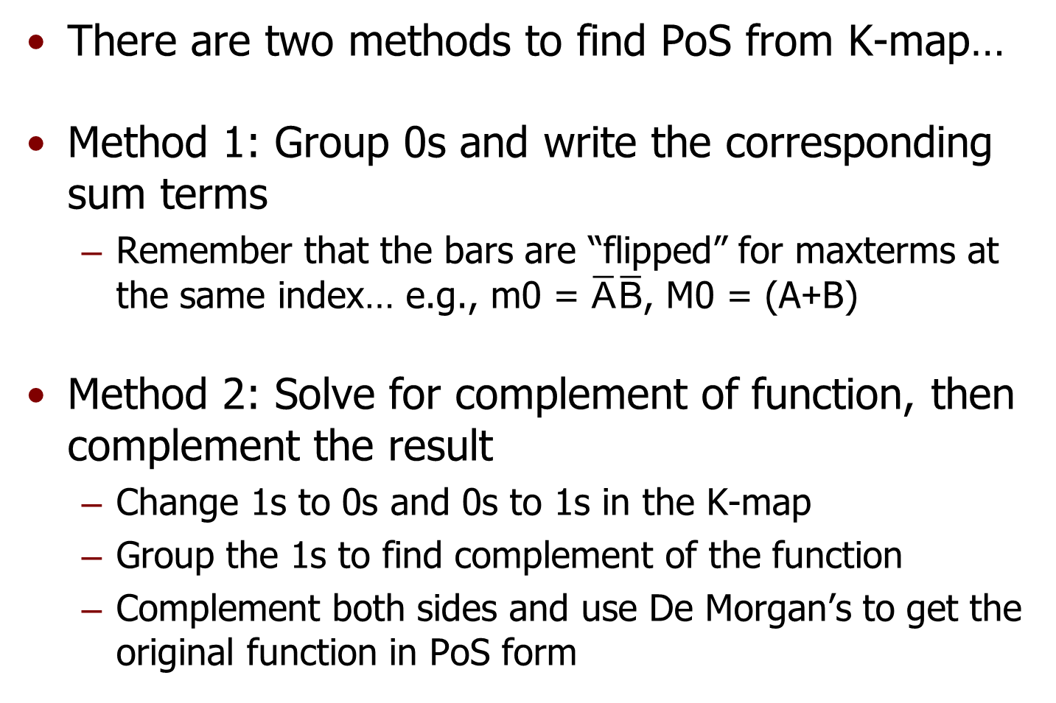
K-Maps and Product-of-Sums
There are two methods to find PoS from K-map…
Method 1: Group 0s and write the corresponding sum terms
Remember that the bars are “flipped” for maxterms at the same index… e.g., m0 = $\overline{\text{A}} \overline{\text{B}}$, M0 = ($\text{A}\text{+}\text{B}$)
Method 2: Solve for complement of function, then complement the result
Change 1s to 0s and 0s to 1s in the K-map
Group the 1s to find complement of the function
Complement both sides and use De Morgan’s to get the original function in PoS form
Notes:
There are two approaches that we can use to find a product of sums implementation from a K-map. In the first method, we group 0s and directly write the corresponding sum terms, which we then AND together. Remember that the complement bars on a particular maxterm are flipped as compared to the minterm with the same index. For example, minterm m0 is /A·/B, while maxterm M0 is A+B. Alternatively, we can use the K-map to solve for the complement of the function as a sum of products, then complement that and use Boolean algebra to put it into product of sums form.

Slide 14
PoS Simplification – Method 1
Group 0s, then interpret them as sum terms of F (similar to minterms vs. maxterms)
CD
AB
00
01
11
10
00
0
1
0
0
F =
(A+D)
F =
(A+D) · (C+D)
01
0
1
0
0
11
1
1
0
1
10
1
1
0
1
Notes:
Here we demonstrate how to directly obtain the product of sums implementation by grouping 0s and writing the corresponding sum terms. First, we group the pairs of zeros at left and right, which results in the sum term A+D. Next we group the column of 0s, which results in the sum term /C + /D. Note this term will only be false if both C and D are true, as indicated in the K-map labelling for this column. The optimal product of sums form is directly obtained as the product of these two sum terms.

Slide 15

PoS Simplification – Method 2
Normally group 1s for F… now, 0s for $\overline{\text{F}}$
Then use De Morgan’s to find original F in PoS
CD
AB
00
01
11
10
F =
AD
+ CD
00
0
1
0
0
F =
AD
+ CD
01
0
1
0
0
=
(AD) · (CD)
11
1
1
0
1
F =
(A+D) · (C+D)
10
1
1
0
1
Notes:
To use the function’s complement to find the PoS solution, we can group 0s but treat them as though they were 1s. This gives us the complement of F in sum of products form: /F = /A·/D + C·D. Now, we complement both sides to preserve equality, remove the double complement bars, and then apply De Morgan’s Law to algebraically transform the function into product of sums form. Note that the answer we arrive at is the same as we found using the other method.

Slide 16
ECE 352 Digital System Fundamentals
Optimization with K-Maps
Notes:
This concludes our video on optimization with K-maps.

